Slide 1
MX2020 Big Data
Event Hub Reference Architecture
Mayo 10, 2019

Slide 2
Change control
Versión | Fecha | Descripción del Cambio | Autor/Departamento
0.1 | 10/05/2019 | Creation of the document | [Big Data Architecture]
1.1 | 02/08/2019 | Integration pattern diagram, general component diagram, internal structure diagram of the citiIntegration component and citiConsumerEngine are incorporated | [Big Data Architecture]
1.2 | 05/08/2019 | Document structure and component diagram of the Event Hub architecture are modified | [Big Data Architecture]
1.3 | 07/08/2019 | Integration of the Impact of Dimensions on Systemic Qualities table | [Big Data Architecture]
1.4 | 16/08/2019 | Include a pattern of API Producer Service | [Big Data Architecture]

Slide 3
Change control
Versión | Fecha | Descripción del Cambio | Autor/Departamento
1.5 | 10/08/2019 | Include a pattern of API Producer Service, API layers diagram | [Big Data Architecture]
1.6 | 06/08/2019 | Internal structure of the ProducerService API is included | [Big Data Architecture]

Slide 4
Table of Contents
Features and terminology
Needs and Solution Proposal
Graphic Representation of the Solution
Infrastructure and Connectivity
General services
Risks and Dependencies
Standards, Patterns and Decisions of Architecture
References and Annexes

Slide 5
Features and terminology

Slide 6






Features and terminology (I)
Event Hub Architecture – Kafka Connect
Consumer over REST/JSON
Brokers
Kafka Consumer
Kafka REST Proxy
Kafka Cluster (Brokers, Zookeeper)
Serving Layer
1.
Job Stream
Kafka Cluster (Brokers, Zookeeper)
Kafka Producer
Name Events (Topic)
2.
Prepackaged Connectors for input (source)
Transforms Creates new streams Aggregates Joins Analysis
Stream APIs
Kafka Cluster (Brokers, Zookeeper)
Kafka Steam / SQ
L
Name Events (Topic)
Search
Name Events (Topic)
3.
Indexed for Search
Name Events (Topic)
Name Events (Topic)
Key Value Storage
Kafka Connect
Sink
Name Events (Topic)
Job Real Time Analytics
4.
Name Events (Topic)
Business Intelligence
Name Events (Topic)
Oracle
Name Events (Topic)
5.
Job Real Time Analytic
s
Name Events (Topic)
Name Events (Topic)
Newsfeed
Name Events (Topic)
Prepackaged Connectors for output (source)
6.
Input Data Stream
Name Events (Topic)
Name Events (Topic)
Kafka Connect
Source
Data Bases
Name Events (Topic)
OLAP
7.
Name Events (Topic)
Name Events (Topic)
Name Events (Topic)
Log aggregation
Cognitive
8.
Data Capture
Name Events (Topic)
Name Events (Topic)
Output Data Streams
S3
Oracle, DB2, Tandem
Name Events (Topic)
n…
Host standby
cluster for disaster recovery in another data center

Slide 7
Features and terminology (II)
Event Hub Architecture – Topics, Partitions and Offsets
Topics: a particular stream of data
Similar to a table in database (without all the constraints)
It have as many topics as you want
A Topic is identified by its name
Topics are split in partitions
Each partition is ordered
Each massage within a partition gets an incremental id, called offset
Partition 0
0
1
2
3
4
5
6
7
8
9
10
11
12
13
Offset only have a meaning for a specific partition
Order is guaranteed only within a partition (not across partitions)
Data is Kept only for a limited time
Once the data is written to partition, it can't be changed (immutability)
Data is assigned randomly to a partition unless a key is provided
Kafka Topic
Partition 1
0
1
2
3
4
5
6
7
8
writes
Partition 2
0
1
2
3
4
5
6
7
8
9
10

Slide 8
Features and terminology (III)
Event Hub Architecture – Topics Replication factor
Topic should have a replication factor > 1 (usually between 2 and 3)
This way if a broker is down, another broker can serve the data
Example: Topic-A with 2 partition and replication factor of 2
Broker 1
Broker 2
Broker 3
Partition 0
Topic-A
Partition 1
Topic-A (Leader)
Partition 0
Topic-A (Leader)
Partition 0
Topic-A
Example lost Broker 2
Result: Broker 1 and 3 can still serve the data
Broker 1
Broker 2
Broker 3
Partition 0
Topic-A
Partition 1
Topic-A (Leader)
Partition 0
Topic-A (Leader)
Partition 0
Topic-A

Slide 9
Features and terminology (IV)
Event Hub Architecture – Producer and Massage Keys
Producer write data to topic (which is made of partitions)
Producer automatically know to which broker and partition to write to
In case of Broker failures, Producer will automatically recover
Producer can choose to replicas acknowledgment of data writes:
acts=0: Producer won’t wait acknowledgement (possible data loss)
acts=1: Producer won’t wait acknowledgement (limited data loss)
acts=all: Producer won’t wait acknowledgement (possible data loss)
Broker 1
0
1
2
3
4
5
6
7
8
9
10
11
12
13
Partition 0
Topic-A / Partition 0
writes
Broker 1
Producer
Send data
0
1
2
3
4
5
6
7
8
Partition 0
Topic-A / Partition 1
The Load is balanced to many brokers thanks to the number of partitions
Broker 1
0
1
2
3
4
5
6
7
8
9
10
Partition 0
Topic-A / Partition 2

Slide 10
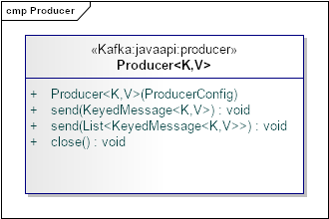
Features and terminology (V)
Event Hub Architecture – Producer
Producers are applications that create messages and publish them to the Kafka broker for further consumption. These producers can be different in nature; for example, frontend applications, backend services, proxy applications, adapters to legacy systems, and producers for Hadoop. These producers can also be implemented in different languages such as Java, Scala, C, and Python.
The Kafka API for message producers
For high efficiency in Kafka, producers can also publish the messages in batches that work in asynchronous mode only. In asynchronous mode, the producer works either with a fixed number of messages or fixed latency defined by producer configuration, queue.time or batch.size, respectively.
K: Type of the optional key associated with the message for message partition V: Type of the message
Sends producer data to a single topic using either synchronous or asynchronous mode, optionally partitioned by key
Takes ProduceConfig as argument with contains the property values required for broker connection
Sends list of producer data to multiple topics using either synchronous or asynchronous mode, optionally partitioned by key
Close the producer pool connections to all Kafka brokers. Also close the zookeeper client connection if any.

Slide 11
Features and terminology (VI)
Event Hub Architecture – Producer
metadata.broker.list: this property specifies the list of intermediaries (in the format [<node: port>, <node: port>]) to which the producer must connect. Kafka producers automatically determine the leading broker for the subject, divide it by means of a metadata request and connect to the correct broker before publishing any message.
Defining properties
Properties props = new Properties();
props.put("metadata.broker.list"," name_server :9092, name_server:9093, name_server :9094");
props.put("serializer.class","kafka.serializer.StringEncoder");
props.put("request.required.acks", "1");
ProducerConfig config = new ProducerConfig(props);
Producer<String, String> producer = new Producer<String, String> (config);
serializer.class: This property specifies the serializer class that needs to be used while preparing the message for transmission from the producer to the broker. In this example, we will be using the string encoder provided by Kafka. By default, the serializer class for the key and message is the same, but we can also implement the custom serializer class by extending the Scala-based kafka.serializer.Encoder implementation. Producer configuration key.serializer.class is used to set the custom encoder.
Building the message and sending it
String runtime = new Date().toString();;
String msg = "Message Publishing Time - " + runtime;
KeyedMessage<String, String> data = new KeyedMessage<String, String> (topic, msg);
producer.send(data);
request.required.acks: This property instructs the Kafka broker to send an acknowledgment to the producer when a message is received. The value 1 means the producer receives an acknowledgment once the lead replica has received the data. This option provides better durability as the producer waits until the broker acknowledges the request as successful. By default, the producer works in the "fire and forget" mode and is not informed in the case of message loss.

Slide 12
package mx.citi.bigdata.common;
import java.util.Date;
import java.util.Properties;
import kafka.javaapi.producer.Producer;
import kafka.producer.KeyedMessage;
import kafka.producer.ProducerConfig;
public class SimpleProducer {
private static Producer<String, String> producer;
public SimpleProducer() {
Properties props = new Properties();
props.put("metadata.broker.list",
"197.168.128.132:9092, 197.168.128.132:9093,
197.168.128.132:9094");
props.put("serializer.class", "kafka.serializer.StringEncoder");
props.put("request.required.acks", "1");
ProducerConfig config = new ProducerConfig(props);
producer = new Producer<String, String>(config);
}
public static void main(String[] args) {
int argsCount = args.length;
if (argsCount == 0 || argsCount == 1)
throw new IllegalArgumentException(
"Please provide topic name and Message count as arguments");
String topic = (String) args[0];
String count = (String) args[1];
int messageCount = Integer.parseInt(count);
System.out.println("Topic Name - " + topic);
System.out.println("Message Count - " + messageCount);
SimpleProducer simpleProducer = new SimpleProducer();
simpleProducer.publishMessage(topic, messageCount);
}
private void publishMessage(String topic, int messageCount) {
for (int mCount = 0; mCount < messageCount; mCount++) {
String runtime = new Date().toString();
String msg = "Message Publishing Time - " + runtime;
System.out.println(msg);
KeyedMessage<String, String> data =
new KeyedMessage<String, String>(topic, msg);
producer.send(data);
}
producer.close();
}
}
Features and terminology (VII)
Event Hub Architecture – Producer (Simple Java Producers)
Se t the broker list for requesting metadata to find the lead broker.
This specifies the serializer class for keys.
1 means the producer receives an acknowledgment once the lead replica
has received the data. This option provides better durability as the
client waits until the server acknowledges the request as successful.
Topic name and the message count to be published is passed from the command line.
Creates a KeyedMessage instance
Publish the message
Creates a KeyedMessage instance
¡
Note: This is an example, it is recommended the use of good practices at the design and language level in which the producer will be implemented

Slide 13
Features and terminology (VIII)
Event Hub Architecture – Producer (Simple Scala Producers)
Set the broker list for requesting metadata to find the lead broker.
package mx.citi.bigdata.common;
import java.util.Properties
import org.apache.kafka.clients.producer.{KafkaProducer, ProducerRecord}
object KafkaProducerApp extends App {
val props:Properties = new Properties()
props.put("bootstrap.servers"197.168.128.132:9092,
197.168.128.132:9093,
197.168.128.132:9094")
props.put("key.serializer",
"org.apache.kafka.common.serialization.StringSerializer")
props.put("value.serializer",
"org.apache.kafka.common.serialization.StringSerializer")
props.put("acks","all")
val producer = new KafkaProducer[String, String](props)
val topic = "text_topic"
try {
for (i <- 0 to 15) {
val record = new ProducerRecord[String, String](topic, i.toString, ”Produce" + i)
val metadata = producer.send(record)
printf(s”Sent Record(key=%s value=%s) " +
"meta(partition=%d, offset=%d)\n",
record.key(), record.value(),
metadata.get().partition(),
metadata.get().offset())
}
}catch{
case e:Exception => e.printStackTrace()
}finally {
producer.close()
}
}
This specifies the serializer class for keys.
The producer is thread safe and sharing a single producer instance across threads will generally be faster than having multiple instances.
Creates a record to be sent to a specified topic and partition
Send the given record asynchronously and return a future which will eventually contain the response information.
Close producer connection with broker
¡
Note: This is an example, it is recommended the use of good practices at the design and language level in which the producer will be implemented

Slide 14
Features and terminology (IX)
Event Hub Architecture – Consumers & Consumer Groups
Consumer
Consumer read data from topic (identified by name)
Consumer Know with broker to read from
In case of broker failures, consumers know how to recover
Data is read in order within each partitions
Broker 1
Read in order
Consumer
0
1
2
3
4
5
6
7
8
9
10
11
12
Partition 0
Topic-A / Partition 0
Broker 1
Consumer
Producer
Partition 0
Topic-A / Partition 1
0
1
2
3
4
5
6
7
8
Read in order
Broker 1
0
1
2
3
4
5
6
7
8
9
10
Partition 0
Topic-A / Partition 2

Slide 15
Features and terminology (X)
Event Hub Architecture – Consumers & Consumer Groups
Consumer Groups
Consumer read data in consumer groups
Each consumer within a group read from exclusive partition
If you have more consumers than partition, some consumers will be inactive
Topic-A
Partition 0
Topic-A
Partition 0
Topic-A
Partition 0
Co
Consumer-group-partition-1
Co
Consumer-group-partition-2
Co
Consumer-group-partition-3
Consumer 1
Consumer 2
Consumer 1
Consumer 2
Consumer 3
Consumer 1

Slide 16
Features and terminology (XI)
Event Hub Architecture – Consumers Offsets
Consumer Groups
Kafka stores the offset at which a consumer group has been reading
The offsets committed live in kafka topic named __consumer_offsets
When a consumer in group has processed data received from kafka, it should be committing the offsets
If a consumer dies, it will be able to read back from where it left off thanks to the committed consumer offset
Committed offset
Consumer from Consumer Group
4258
4259
4260
4261
4262
4263
4264
4265
4266
4267
4268
Reads

Slide 17
Features and terminology (XII)
Event Hub Architecture – Zookeeper
Zookeper
Zookeeper manager brokers (Keeps a list of them)
Zookeeper help in performing leader election for partition
Zookeeper send notification to Kafka in case of change (new topic, broker comes up delete topics, etc.)
Kafka can’t work without Zookeeper
Zookeeper by design operates with an odd number of server (3,5,7)
Zookeeper has a leader (handle writes) the rest of the server are followers (handle reads)

Slide 18
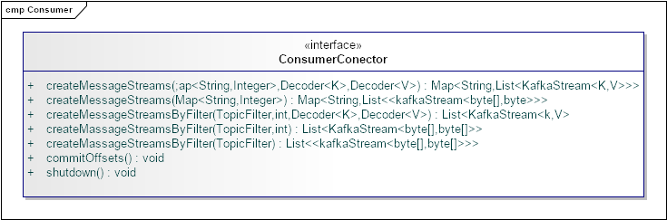
Features and terminology (XII)
Event Hub Architecture – Consumers High-level API
The createMessageStreams method creates a list of massage streams for each topic.
The createMassageStremsByFilter method creates a lists of mages streams for all topics that match given filter.
This the main interface for Java-based consumers.
ConsumerConnector: Kafka provides the ConsumerConnector interface (interface ConsumerConnector) that is further implemented by the ZookeeperConsumerConnector class (kafka.javaapi.consumer.ZookeeperConsumerConnector). This class is responsible for all the interaction a consumer has with ZooKeeper.
Commit the offsets of all broker partition connected by this connector.
Shut down the connection of connector with Zookeeper

Slide 19
Features and terminology (XIII)
Event Hub Architecture – Consumers High-level API
KafkaStream: Objects of the kafka.consumer.KafkaStream class are returned by the createMessageStreams call from the ConsumerConnector implementation. This list of the KafkaStream objects is returned for each topic, which can further create an iterator over messages in the stream.
Defining properties
class KafkaStream[K,V](private val queue:
BlockingQueue[FetchedDataChunk],
consumerTimeoutMs: Int,
private val keyDecoder: Decoder[K],
private val valueDecoder: Decoder[V],
val clientId: String)
The parameters K and V specify the type for the partition key and message value, respectively
The low-level consumer API
The high-level API does not allow consumers to control interactions with brokers. Also known as "simple consumer API", the low-level consumer API is stateless and provides fine grained control over the communication between Kafka broker and the consumer. It allows consumers to set the message offset with every request raised to the broker and maintains the metadata at the consumer's end. This API can be used by both online as well as offline consumers such as Hadoop. These types of consumers can also perform multiple reads for the same message or manage transactions to ensure the message is consumed only once.
Compared to the high-level consumer API, developers need to put in extra effort to gain low-level control within consumers by keeping track of offsets, figuring out the lead broker for the topic and partition, handling lead broker changes, and so on.
In the low-level consumer API, consumers first query the live broker to find out the details about the lead broker. Information about the live broker can be passed on to the consumers either using a properties file or from the command line. The topicsMetadata() method of the kafka.javaapi.TopicMetadataResponse class is used to find out metadata about the topic of interest from the lead broker. For message partition reading, the kafka.api.OffsetRequest class defines two constants: EarliestTime and LatestTime, to find the beginning of the data in the logs and the new messages stream. These constants also help consumers to track which messages are already read.

Slide 20
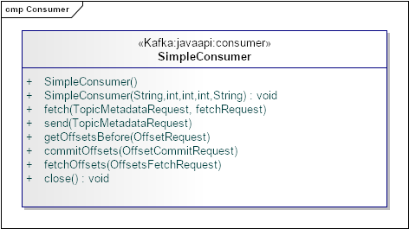
Features and terminology (XIV)
Event Hub Architecture – Consumers Low-level API
This method returns the set of messages from topic. Here FetchRequest specifies the topic name, topic partition, strating byte offset, and maximus byte to be fetched.
Consumer class for Kafka massages, accepts lead broker, broker port, connection timeout, buffer size, and client ID.
The method returns the list of valid offsets before the given time.
The method commits the offsets for a topic passed as OffsetCommitRequest.
This method returns the set of messages from topic. Here FetchRequest specifies the topic name, topic partition, strating byte offset, and maximus byte to be fetched.
This method returns the offsets for a topic passed as OffsetFetchRequest.
Shut down the connection of connector with Zookeeper

Slide 21
Features and terminology (XV)
Event Hub Architecture – Consumers Low-level API
Simple Java consumers
This is a single-threaded simple Java consumer developed using the high-level consumer API for consuming the messages from a topic.
Defining properties
Properties for making a connection with Zookeeper and pass these properties to the Kafka consumer
zookeeper.connect: This property specifies the ZooKeeper <node:port> connection detail that is used to find the Zookeeper running instance in the cluster. In the Kafka cluster, Zookeeper is used to store offsets of messages consumed for a specific topic and partition by this consumer group.
group.id: This property specifies the name for the consumer group shared by all the consumers within the group. This is also the process name used by Zookeeper to store offsets.
Properties props = new Properties();
props.put("zookeeper.connect", "localhost:2181");
props.put("group.id", "testgroup");
props.put("zookeeper.session.timeout.ms", "500");
props.put("zookeeper.sync.time.ms", "250");
props.put("auto.commit.interval.ms", "1000");
new ConsumerConfig(props);
zookeeper.session.timeout.ms: This property specifies the Zookeeper session timeout in milliseconds and represents the amount of time Kafka will wait for Zookeeper to respond to a request before giving up and continuing to consume messages.
auto.commit.interval.ms: This property defines the frequency in milliseconds at which consumer offsets get committed to Zookeeper.
zookeeper.sync.time.ms: This property specifies the ZooKeeper sync time in milliseconds between the ZooKeeper leader and the followers.
¡
Note: This is an example, it is recommended the use of good practices at the design and language level in which the producer will be implemented

Slide 22
Features and terminology (XVI)
Event Hub Architecture – Zookeeper
Zookeeper
Zookeeper
Zookeeper
Server 1
(Follower)
Server 1
(Leader)
Server 1
(Follower)
Kafka
Kafka
Kafka
Kafka
Kafka
Broker 1
Broker 2
Broker 3
Broker 4
Broker 5

Slide 23
Features and terminology (XVII)
Event Hub Architecture – Even Driver
The three mechanisms through which services interact
Service
Commands are actions—requests for some operation to be performed by another service, something that will change the state of the system. Commands execute synchronously and typically indicate completion, although they may also include a result.
Example: processPayment(), returning whether the payment succeeded.
When to use: On operations that must complete synchronously, or when using orchestration or a process manager. Consider restricting the use of commands to inside a bounded context.
Events are both a fact and a notification. They represent something that happened in the real world but include no expectation of any future action. They travel in only one direction and expect no response (sometimes called “fire and forget”), but one may be “synthesized” from a subsequent event.
Example: OrderCreated{Widget}, CustomerDetailsUpdated{Customer}
When to use: When loose coupling is important (e.g., in multiteam systems), where the event stream is useful to more than one service, or where data must be replicated from one application to another. Events also lend themselves to concurrent execution.
Queries are a request to look something up. Unlike events or commands, queries are free of side effects; they leave the state of the system unchanged.
Example: getOrder(ID=42) returns Order(42,…)
When to use: For lightweight data retrieval across service boundaries, or heavyweight data retrieval within service boundaries.
REQUEST - DRIVEN
EVENT - DRIVEN
serviceNameWidget()
Command
Logic
“Widget - Just happened”
Event
State
Change
No state
change
getListService(parameter)
Query
Commands, events, and queries

Slide 24

Features and terminology (XVIII)
Event Hub Architecture – Even Driver
Others work out what they should do next
I broadcast what I did
Logic
Logic
Kafka
Logic
Queries don´t span context, they use a local copy of the replicated events
Logic
Event-driven approaches demonstrating how event-driven approaches provide less coupling

Slide 25
Features and terminology (XIX)
Event Hub Architecture – Even Driver Core
Synchronous Edge
Service
UI Tier
Kafka
Kafka
Kafka
Event Driver Core
Kafka
Event Only

Slide 26
Needs and Solution Proposal

Slide 27
Needs and Solution Proposal (I)
Descripción de la solución técnica
Objective
Define core components, pieces of code for the CitiBanamex Even Hub Reference Architecture
Scope
Graphically represent the components, their integrations and the use of good practices in the development of software engineering processes.
Description
Event Hub is a highly scalable data streaming platform and event ingestion service, capable of receiving and procession millions of events per second. Event Hub can process and store events, data or telemetry produced by distributed software and devices. Data sent to an event hub can be transformed and stored using any real-time analytics provider or batching/storage adapters. With the ability to provide publish-subscribe capabilities with low latency and at massive scale, Event Hubs services as the “on-ramp” for Big Data.
Even Hub and telemetry handling capabilities make it especially useful for:
Application instrumentation
User expediencies or workflow processing
Enable behavior tracking in mobile apps, traffic information from web farms, connected with other devices

Slide 28









Needs and Solution Proposal (II)
Event Hub Architecture
Event Hub channels the events. So Event Hub is a component or services that is located between event editors and event consumers to decouple the production of event flow from the consumption of those events. The following figure represents this architecture:
Even Produces
Collection
Ingress
Stream
Processing
Long-term
storage
Presentation /
Action
Event Hub feature following key elements:
Event producers/publishers: An entity that sends data to an event hub.
Capture: Enables you to capture Event Hubs streaming data and store it in an Azure Blob storage account
Partitions: Enables each consumer to only read a specific subset, or partition, of the event stream.
Tokens: Identifies and authenticates the event publisher
Event consumers: An entity that reads event data from an event hub
Consumer groups : Provides each multiple consuming application with a separate view of the event stream, enabling those consumers to act independently.
Throughput units: Pre-purchased units of capacity. A single partition has a maximum scale of 1 throughput unit.
Application
Service bus
Stream
APIs
APIs
E
Stream
processing
DBs
E
Devices
Event Hub
Storage
Search and Query
Legacy Systems
Slow Data
Data Lake
Analytics
Heterogeneous
Data Sources
Reports

Slide 29
Needs and Solution Proposal (III)
Event Hub Architecture – The key capabilities of an Event Hub
Event Hub | Description
Pub / Sub | Enable real-time publishing and subscribing to data streams at scale, in particular: Provide single-digit latency so it is usable by real-time applications Able to handle high volume data streams such as are common for log data, or other usage across many applications Enable integration with passive data systems such as databases as well as applications that actively publish events
Process | Enable the real-time stream processing of streams at scale Support modern stream processing capabilities to power real-time applications or streaming transformations
Store | Be able to reliably store streams of data at scale. In particular: It provides solid guarantees of replication and order to handle critical updates, such as replicating the record of changes in a database in a replica store as a search index, delivering this data in order and without loss. It is capable of storing or storing data for long periods of time. This allows integration with batch systems (such as a data warehouse) that only load data periodically, as well as allowing the flow processing systems to reprocess the sources when their logic changes. Storage must be economical enough for the platform to be viable at scale.

Slide 30
Needs and Solution Proposal (IV)
Event Hub Architecture – The key capabilities of an Event Hub
Points to highlight about the relationship this event streaming platform concept has with other.
System | Description
Messaging | Even Hub is similar to an enterprise messaging system: it receives messages and distributes to interested subscribers. It is considered as a type of messaging 2.0. There are three important differences: Messaging systems usually run in single implementations for different applications. Because Even Hub runs as a cluster and can be scaled, a central instance can support a complete data center The messaging systems have limitations in the work of data storage and this limits them to flows that only have consumption in real time. However, many integrations require more than this The semantics of messaging systems are not easily compatible with rich flow processing, so they really can not be used as the basis for the processing of Even Hub
Data Integration Tools | Enable the real-time stream processing of streams at scale Support modern stream processing capabilities to power real-time applications or streaming transformations One practical area of overlap is that by making the data available in a uniform format in one place with a common abstraction stream, many of the routine data cleaning tasks can be completely avoided
Enterprise Service Buses | The advantage of Even Hub is that the transformation is fundamentally decoupled from the flow itself. This code can live in applications or transmit processing tasks, allowing teams to go their own pace without a central bottleneck for the development of the application.
Change Capture Systems | Databases have long had similar log mechanisms such as Golden Gate. However these mechanisms are limited to database changes only and are not a general purpose event capture platform. They tend to focus primarily on the replication between databases, often between instances of the same database system (e.g. Oracle-to-Oracle).

Slide 31
Needs and Solution Proposal (V)
Event Hub Architecture – The key capabilities of an Event Hub
Points to highlight about the relationship this event streaming platform concept has with other.
System | Description
Data Warehouses and Apache Hadoop | Event Hub does not replace data warehouse; It acts as a conduit for data to flow quickly for long-term retention, ad hoc analysis and batch processing. That same channel can be executed in reverse to publish the results derived from the processing by night or hourly batches.
Stream Processing Systems | External flow processing structures, such as Storm, Samza, Flink or Spark Streaming, can be used to provide the capacity of a transmission platform. They try to add additional processing for transformations in real time

Slide 32
Needs and Solution Proposal (VI)
Event Hub Architecture – Event streaming platform
App
App
App
App
A modern stream-centric data architecture
Social Graph
Search
Key Value Storage
Oracle
Newsfeed
OLAP
In Event-Hub Kafka acts as a type of universal channeling for data. Each system can feed this central duct or be fed by it; the applications or flow processors can access it to create new derived flows, which in turn can be fed back into the various systems to serve.
An event streaming platform has two primary uses:
Kafka
Streaming Platform
citiIntegrationSource
Data Capture
Stream processing: It enables continuous, real-time applications built to react to, process, or transform streams. This is the natural evolution of the world of Enterprise Messaging which focused on single message delivery, stream processing gives you that and more.
Data Integration: The event streaming platform captures streams of events or data changes and feeds these to other data systems such as relational databases, key-value stores, Hadoop, or
Log Search
App
Monitoring
Stream APIs
App
Principles of Even Hub
Security & Fraud
Stream
Processing
Most of what CitiBanamex does can be considered as a series of events
Data is more than rows in databases, they are events
Real Time Analytics
cmpCityStreamProcessing
citiIntegrationSink
Storage Layer
Hadoop
Data Visualization tools
A modern stream-centric data architecture

Slide 33
Needs and Solution Proposal (VII)
Event Hub Architecture – Integration Patterns
Event Producer
Event Hub
Event Consumer
Event Producer
Solace
Stream App
Stream App
A
Stream App
A
Kafka Custom API Source
Eclipse CRP
B
MQ/JMS/Kafka Custom API Source
B
Solace/Kafka Custom API Source
ATM´s
Kafka Connect Cluster – Worker 3
Kafka Cluster
(Brokers, Zookeeper)
Kafka Connect Cluster – worker 3
C
Name Events (Topic)
JDBC/ Kafka Custom API Source
Alertas
C
Kafka Connect Cluster – Worker 2
Kafka Cluster
(Brokers, Zookeeper)
Kafka Connect Cluster – worker 2
D
Name Events (Topic)
Name Events (Topic)
Name Events (Topic)
A
Name Events (Topic)
EMS/ Kafka Custom API Source
Name Events (Topic)
CAP
E
Kafka Connect Cluster – Worker 1
Kafka Cluster
(Brokers, Zookeeper)
Kafka Connect Cluster – worker 1
COP
D
Name Events (Topic)
Name Events (Topic)
Name Events (Topic)
Name Events (Topic)
Name Events (Topic)
Data Capture
Name Events (Topic)
Name Events (Topic)
B
F
Name Events (Topic)
TECOS
Name Events (Topic)
Abinitio ETL
E
Name Events (Topic)
Name Events (Topic)
G
TIBCO
Connector 1
Task 1
Name Events (Topic)
Connector 1
Task 1
Name Events (Topic)
Name Events (Topic)
Name Events (Topic)
Name Events (Topic)
Event Consumer
Name Events (Topic)
C
EAP
F
Name Events (Topic)
Name Events (Topic)
Name Events (Topic)
IBM
Name Events (Topic)
Connector 3
Task 1
Name Events (Topic)
Name Events (Topic)
Connector 3
Task 1
Name Events (Topic)
Name Events (Topic)
A
JDBC/Kafka Connector Source
Name Events (Topic)
Kafka Connect
Sink
D
F
Name Events (Topic)
Mongo
Oracle
Name Events (Topic)
Kafka Custom API Sink
Name Events (Topic)
Name Events (Topic)
Name Events (Topic)
Name Events (Topic)
Name Events (Topic)
B
Connector 2
Task 2
Name Events (Topic)
Name Events (Topic)
Connector 2
Task 2
HDFS/Hive/Kafka Custom API Sink
F
Name Events (Topic)
E
Engine Evaluator
C
Tandem
Name Events (Topic)
Name Events (Topic)
AbInitio ETL
Name Events (Topic)
Name Events (Topic)
Name Events (Topic)
D
Abinitio ETL
Data Capture
Connector 3
Task 1
Name Events (Topic)
Connector 3
Task 1
F
Name Events (Topic)
MDM
Name Events (Topic)
Name Events (Topic)
Name Events (Topic)
Name Events (Topic)
Unisys
G
Name Events (Topic)
Name Events (Topic)
AbInitio
ETL

Slide 34
Needs and Solution Proposal (VIII)
New component
Event Hub Architecture – Global Architecture SaaS
Component to modify
Component not contemplated
Client
Client
Client
Client
Client
Client
Client
Client
Client
<< uses >>
<< uses >>
<< uses >>
Second phase
<< send>>
ProducerService
ManagmentService
ConsumerService
<< uses >>
<< uses >>
System
Target System
System
System
System
ProducerEngine
<< deploy>
Kafka
Broker
<< use>>
ConsumerEngie
<< send>>
System
System Source
System
<< deploy>>
<< use>>
SinkService
<< connect>>
<< connect>>
<< use>>
StreamService
SourcesService
CommandKafkaService
<< use>>
StreamEngie
<< use>>
SecurityService
First phase
<< use>>

Slide 35
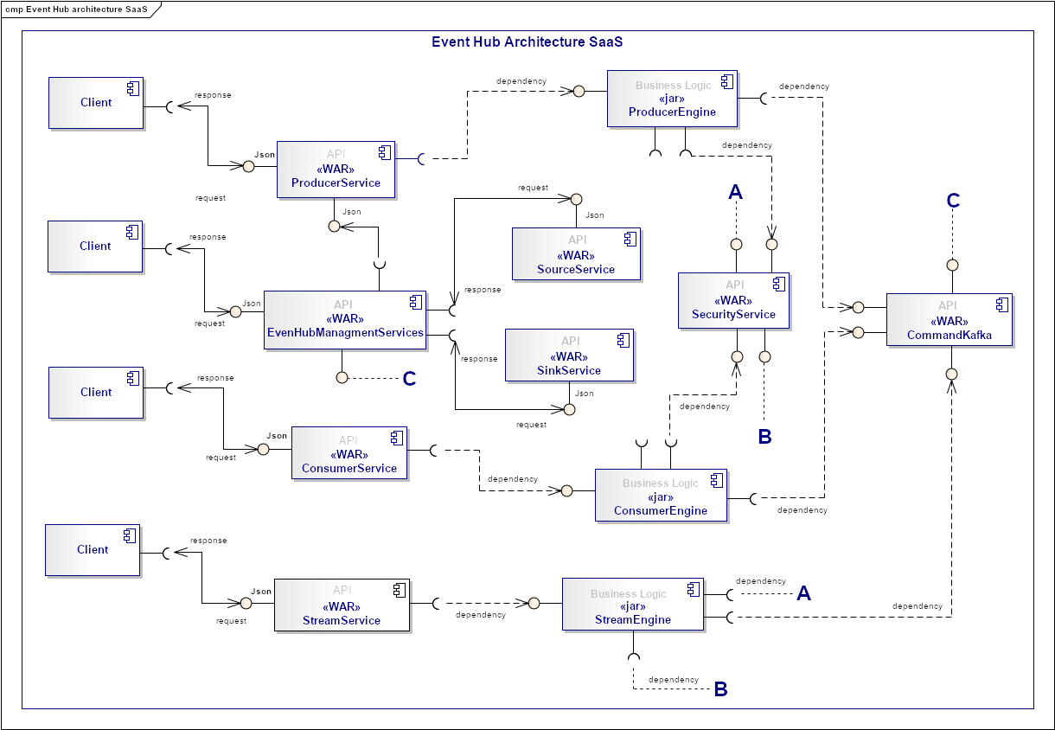
Needs and Solution Proposal (IX)
New component
Component to modify
Event Hub Architecture – Components I
Component not contemplated first phase

Slide 36
Needs and Solution Proposal (X)
New component
Component to modify
Event Hub Architecture – Components II
Component not contemplated first phase
API Layer
EvenHubManagmentServices
ProducerService
StreamService
ConsumerService
ProducerEngine
SecurityService
StreamEngie
ConsumerEngie
Business Layer
Source & Data
Layer
SourceService
CommandService
SinkService

Slide 37
Needs and Solution Proposal (XI)
Event Hub Architecture – Components III
ProducerService
It is the component that has the responsibility of exposing its clients the functionality of sending messages to one or more topics of Kafka. Integrates with ProducerEngine
ConsumerService
It is the component that has the responsibility of exposing to its customers the functionality of consuming messages from one or more topics of Kafka. Integrates with ConsumerEngine
StreamProgressService
It is the component that has the responsibility of exposing to its customers the functionality of processing events of one or more topics of Kafka. Integrates with StreamEngine
ProducerEngine
It is the component that contains the business logic to send from different send one or more events to Kafka topics. Integrates with SourceService, SecurityEngine and CommandKafka
ConsumerEngine
It is the component that contains the business logic to send events of one or more topics of Kafka. Integrates with SinkService, ConsumerEngine and StreamEngine

Slide 38
Needs and Solution Proposal (XII)
Event Hub Architecture – Components IV
SecurityEngine
It is the component that contains the business logic to handle the security of events (data). Integrates with CommandKafkaService.
StreamEngine
It is the component that has the responsibility of exposing its clients the functionality of sending messages to one or more topics of Kafka. Integrates with StreamEngine.
SourceService
It is the component that contains the business logic to connect Citi (source) systems to Kafka. I Integrates with CommandKafkaService and EvenHubManagmentServices.
SinkService
It is the component that contains the business logic to connect Citi (Sink) systems to Kafka. Integrates with CommandKafkaService and EvenHubManagmentServices.
CommandKafkaService
It is the component that contains the business logic to execute Kafka commands and receive requests from its customers
EvenHubManagmentServices
It is the component that provides the necessary functionality for the management of Event Hub. Integrates with CommandKafkaService, SinkService, SourceService and ProducerService.

Slide 39
Needs and Solution Proposal (XII)
Event Hub Architecture – The steps of the architecture for the processing engine
Read the individual events of a Kafka theme (input messages)
Validate the message and send any defective event to a topic dedicated to Kafka called invalid messages
Write the enriched messages in a Kafka theme called valid messages
Input-messages
r1
r2
r3
r4
r5
r6
Processing Engine
Valid-messages
READ
Validation
Enrichment
WRITE
v1
v2
v3
v4
v5
v6
WRITE
invalid-messages
i1
i2
i3
i4
i5
i6

Slide 40
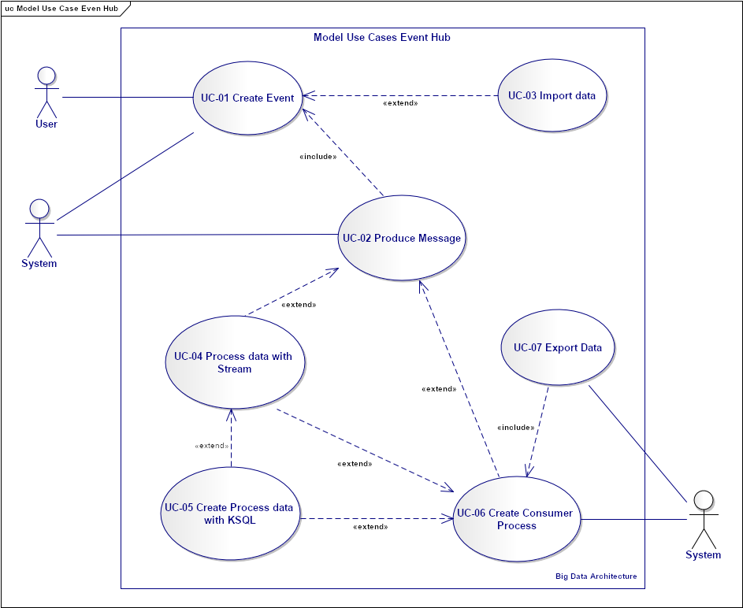
Even Hub
Functional analysis – Use Case 03 Create Produce Message
CU-03 Produce Message - The producer creates new messages. The producer will direct the messages to specific partitions. This is done using the message key and a partitioner that will generate a hash of the key and assign it to a specific partition. This ensures that all messages produced with a given key will be written to the same partition.

Slide 41
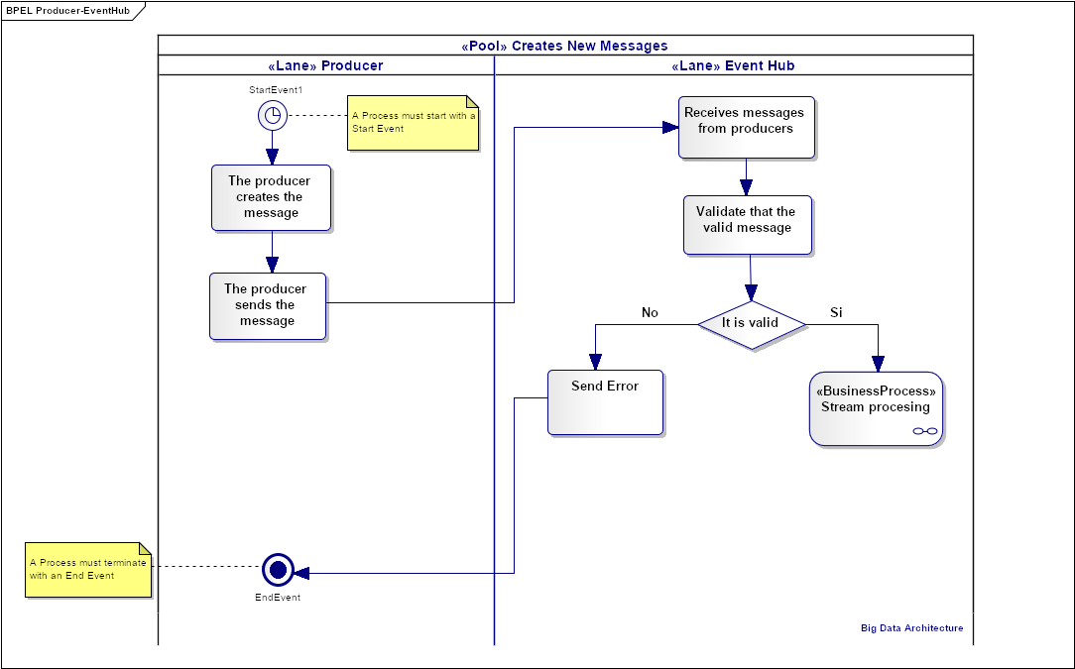
Even Hub
Functional analysis – Flow of Use Case Produce Message
Describe the logic of the steps in a Produce Message use case process.
A call is made to the flow of Stream processing.

Slide 42

Needs and Solution Proposal (XIII)
Event Hub Architecture - Internal Structure Of ProducerService I - (CQRS) pattern
1.
Priority
Event Hub
[POST 1 PUT 1 PATCH ] /message
Business
Logic
Events
Client
Massagge
API
EndPoint
Commands
Event
[GET] /message
Business
Logic
Priority
2.
Client
Massagge
API
Reads
It is combined with event provisioning, as it ensures that all changes made to a resource state are stored as a sequence of immutable events in an event log.
It allows the reconstruction of the last state of the resource simply by reproducing the events.
The solution is very useful not only because it allows different systems to consume changes in resource status such as a series of events in the registry through an Event Hub capability, but also because it allows multiple query or command models to be implemented separately. , thus satisfying the need to admit different representations of data that are easier to scale.

Slide 43
Needs and Solution Proposal (XIII)
Event Hub Architecture - Internal Structure Of ProducerService II
Client
[POST 1 PUT 1 PATCH ] /message
[GET] /message/Id
Inbound adapters
REST API
Producer command headers
Producer Services Business
Logic
Domain event publisher adapter
Adapter
Data Lake
Outbound adapters

Slide 44
Needs and Solution Proposal (XIII)
Event Hub Architecture - Internal Structure Of ProducerService III
Client
[POST] /message
[GET] /message/Id
Inbound adapters
REST API
Producer command headers
Producer Services Business
Logic
Domain event publisher adapter
Adapter
Data Lake
Outbound adapters

Slide 45
Needs and Solution Proposal (XIII)
Event Hub Architecture - Internal Structure Of ProducerService II
Parameters:
topic_name (string) -- Topic to produce the messages to
partition_id (int) -- Partition to produce the messages to
producer_system_id –- id system that send message to Kafka
producer_name_system – name system that send message to Kafka
Request JSON Object:
key_schema (string) -- Full schema encoded as a string (e.g. JSON serialized for Avro data)
key_schema_id (int) -- ID returned by a previous request using the same schema. This ID corresponds to the ID of the schema in the registry.
value_schema (string) -- Full schema encoded as a string (e.g. JSON serialized for Avro data)
value_schema_id (int) -- ID returned by a previous request using the same schema. This ID corresponds to the ID of the schema in the registry.
records -- A list of records to produce to the partition.
Request JSON Array of Objects:
records[i].key (object) -- The message key, formatted according to the embedded format, or null to omit a key (optional)
records[i].value (object) -- The message value, formatted according to the embedded format
DRAFT

Slide 46
Needs and Solution Proposal (XIII)
Event Hub Architecture - Internal Structure Of ProducerService II
Response JSON Object:
key_schema_id (int) -- The ID for the schema used to produce keys, or null if keys were not used
value_schema_id (int) -- The ID for the schema used to produce values.
Response JSON Array of Objects:
offsets (object) -- List of partitions and offsets the messages were published to
offsets[i].partition (int) -- Partition the message was published to. This will be the same as the partition_id parameter and is provided only to maintain consistency with responses from producing to a topic
offsets[i].offset (long) -- Offset of the message
offsets[i].error_code (long) --
An error code classifying the reason this operation failed, or null if it succeeded.
1 - Non-retriable Kafka exception
2 - Retriable Kafka exception; the message might be sent successfully if retried
offsets[i].error (string) -- An error message describing why the operation failed, or null if it succeeded
DRAFT

Slide 47
Needs and Solution Proposal (XIII)
Event Hub Architecture - Internal Structure Of ProducerService III
POST /v1/producer/message HTTP/1.1
Host: kafkaproxy.example.com
Content-Type: application/messaging.v2+json
Accept: application/vnd.kafka.v2+json, application/producer-v1.0+json, application/json
{
"idSystemProducer",
"nameSystemProducer",
"topic",
"records": [
{
"key": "somekey",
"value": {"foo": "bar"}
},
{
"value": 53.5
}
]
}
DRAFT

Slide 48
Needs and Solution Proposal (XIII)
Event Hub Architecture - Internal Structure Of ConsumerService I
1.
Priority
Event Hub
[POST 1 PUT 1 PATCH ] /message
Business
Logic
Events
Client
Massagge
API
EndPoint
Commands
Event
[GET] /message
Business
Logic
Priority
2.
Client
Massagge
API
Reads
It is combined with event provisioning, as it ensures that all changes made to a resource state are stored as a sequence of immutable events in an event log.
It allows the reconstruction of the last state of the resource simply by reproducing the events.
The solution is very useful not only because it allows different systems to consume changes in resource status such as a series of events in the registry through an Event Hub capability, but also because it allows multiple query or command models to be implemented separately. , thus satisfying the need to admit different representations of data that are easier to scale.

Slide 49
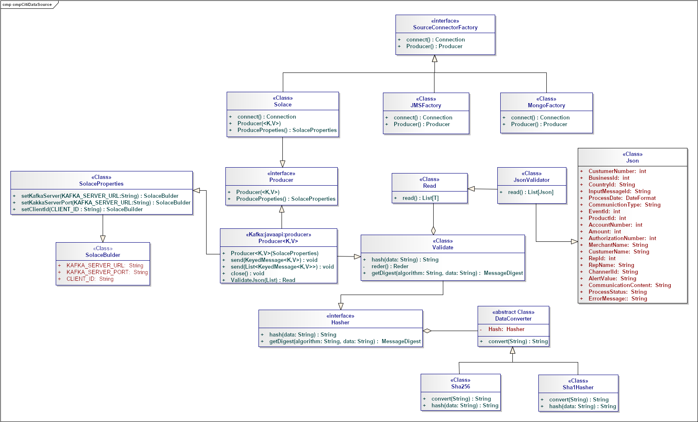
Needs and Solution Proposal (XXII)
Event Hub Architecture Internal Structure Of citiIntegration (Source)

Slide 50
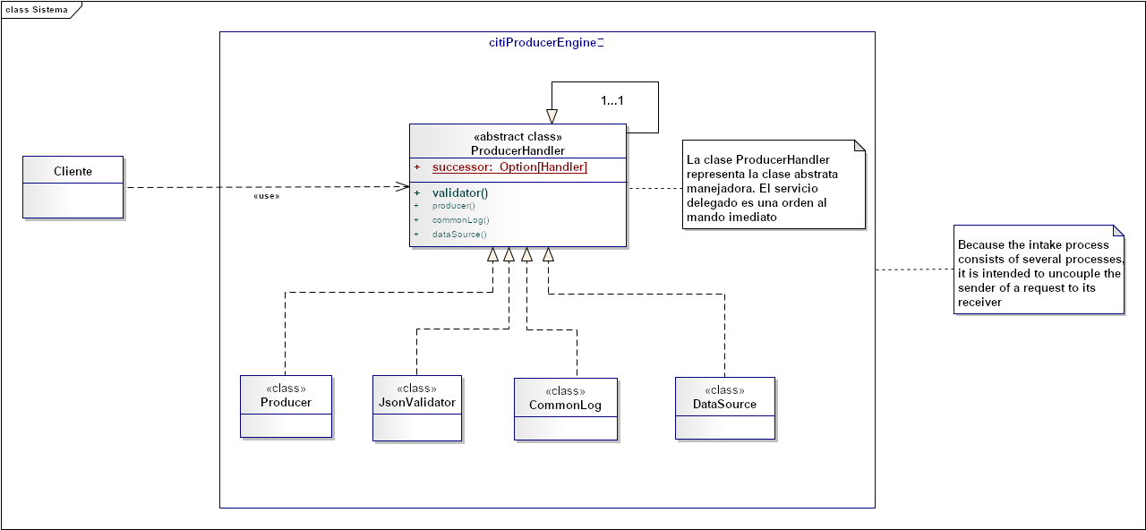
Needs and Solution Proposal (XXIII)
Architecture Internal Structure Of citiProducerEngine

Slide 51
Needs and Solution Proposal (XXIV)
Event Hub Architecture – Impact of Dimensions on Systemic Qualities
Capacity: The dimension of raw power in an element. Capacity is increased through vertical scaling and is sometimes referred to as height.
Redundancy: The dimension in which multiple systems work on the same job. Redundancy is increased through horizontal scaling and is also known as width
Modularity: the dimension into which a system divides into separate elements and disseminates those elements into multiple computer systems
Family | Systemic Qualities | Capacity | Redundancy | Modularity | Comments
Manifest | Performance | + | + | + | The architecture sets a rich and light framework, separation of responsibilities allows each component to fulfill small functionalities.
 | Availability | + | + | + | Replicator allows you to easily and reliably replicate topics from one Kafka cluster to another. In addition to copying the messages, Replicator will create topics as needed preserving the topic configuration in the source cluster. This includes preserving the number of partitions, the replication factor, and any configuration overrides specified for individual topics. Kafka Streams applications can be implemented by running the application jar. It is not necessary to implement the application on a server, which means that you can use any application to run a Kafka Streams application: Docker, Kubernetes, local servers, etc. Something wonderful about Kafka Streams is that it allows horizontal scaling. That is, if it runs on the same JVM, it runs multiple threads, but if multiple instances of the application are started, you can run several JVMs to scale horizontally. The main benefit is that each service is implemented independently and can evolve independently of the others.
Table 1-1 shows the impact of these three dimensions on systemic qualities.

Slide 52
Needs and Solution Proposal (XXV)
Event Hub Architecture – Impact of Dimensions on Systemic Qualities
Capacity: The dimension of raw power in an element. Capacity is increased through vertical scaling and is sometimes referred to as height.
Redundancy: The dimension in which multiple systems work on the same job. Redundancy is increased through horizontal scaling and is also known as width
Modularity: the dimension into which a system divides into separate elements and disseminates those elements into multiple computer systems
Family | Systemic Qualities | Capacity | Redundancy | Modularity | Comments
Operational | Throughput | + | + | +/- | The partition performance that can be achieved in the producer depends on configurations such as batch processing size, compression codec, recognition type, replication factor, etc. However, in general, can be produced at 10s of MB / sec with only a single partition as shown in this reference point.
 | Manageability | - | - | - | Since it is a microservice architecture where your client projects micro-front, in order that the Event Hub is self-service, and with this it is possible to reduce the dependence on manual processes.
 | Security | + | + | + | The use of SSL and Kerberos in the Kafka Cluster, Sprig Security for microservices and / or encryption / decryption algorithms (MD5, Sha1, Sha256) and masking for the data that so require.
 | Serviceability | - | - | - | The measure of this capacity is reduced because the use of IC / CD tools is contemplated in order to shorten times for setting in different environments.
 | Testability | + | + | + | Validate the message and send any defective event to a topic dedicated to Kafka called invalid messages
Developmental | Realizability | + | + | + | The measure of this capacity is reduced because the use of IC / CD tools is contemplated in order to shorten times for setting in different environments.
Table 1-1 shows the impact of these three dimensions on systemic qualities.

Slide 53
Needs and Solution Proposal (XXVI)
Event Hub Architecture – Agile and DevOps
Continuous Delivery / Deployment (CD)
Code
Build
Integrate
Test
Release
Deploy
Operate
Agile Development
Continuous Integration
Continuous Delivery
Continuous Delivery
DevOps

Slide 54









Needs and Solution Proposal (XXVII)
Event Hub Architecture – Agile and DevOps
Integration and continuous deployment
Pull
Download & Test
Test Automation
Source code repository
Binary repository
Deploy
Download & Deploy
Push
{Dev}
Compilation tool
Developer
Package & Test
Task Orchestrator
Even Hub CitiBanamex
Analyze
static code analysis
RML

Slide 55
Needs and Solution Proposal (XXVIII)
Event Hub Architecture – Deploy
<< uses >>
B
<< uses >>
8
StreamEngine
1
Serving Layer
Tibco
ConsumerService
Kafka REST Proxy)
1.
<< uses >>
B
2
ProducerService
(Kafka REST Proxy)
Kafka Cluster (Brokers, Zookeeper)
Solace
Stream APIs
2.
<< uses >>
A
3
Kafka Cluster (Brokers, Zookeeper)
StreamProgressService
Kafka REST Proxy)
Name Events (Topic)
Search
Kafka Cluster (Brokers, Zookeeper)
Indexed for Search
3.
Name Events (Topic)
Kafka Connect
Sources
Name Events (Topic)
Kafka Connect
Sink
Key Value Storage
Name Events (Topic)
Business Intelligence
4.
<< uses >>
Name Events (Topic)
Name Events (Topic)
<< uses >>
4
SourceService
Name Events (Topic)
COP
Name Events (Topic)
5.
Name Events (Topic)
9
SinkService
<< uses >>
Name Events (Topic)
5
Name Events (Topic)
Data Bases
Newsfeed
ProducerEngine
Name Events (Topic)
6.
<< uses >>
Name Events (Topic)
<< uses >>
Name Events (Topic)
Name Events (Topic)
10
B
ConsumerEngine
Cognitive
6
OLAP
ComandKafka
7.
Name Events (Topic)
S3
Name Events (Topic)
Name Events (Topic)
Log aggregation
7
Name Events (Topic)
n…
SecurityEngine
Name Events (Topic)
<< uses >>
Name Events (Topic)
A
<< uses >>

Slide 56
Data completeness

Slide 57
Data completeness
Resumen de Componentes de Infraestructura
With the fibnality of meeting the data complitness requirements, we present a generic view of the dimensions, and those we contemplate should be measured, based on near real time projects.
The quality of the data can refer to the extent of the data (i.e. the values of the data), or the tension of the data (the scheme)
The most common dimensions of data quality:
Dimensiones | Definiciones
Accesibilidad | Grado de disponibilidad de los datos o recuperación fácil y rápida
Cantidad apropiada de datos | Grado de cual volumen de datos es apropiado para la tarea en cuestión
Creibilidad | Grado en que los datos se consideran verdaderos y creíbles
Completo | Grado en el que no faltan datos y es de suficiente amplitud y profundidad para la tarea en cuestión
Representación consistente | Grado en que los datos se presentan en el mismo formato
Facilidad de manipulación | Grado en que los datos son fáciles de manipular y aplicar a diferentes tareas
Libre de errores | Grado en que los datos son correctos y confiables
Interpretabilidad | Grado en que los datos están en los idiomas, símbolos y unidades apropiados, y las definiciones son claras
Objetividad | Grado en que los datos son imparciales, sin prejuicios e imparciales
Pertinencia | Grado en que los datos son aplicables y útiles para la tarea en cuestión
Reputación | Grado en que los datos son altamente considerados en términos de su fuente y contenido

Slide 58
Data completeness
Data Quality Dimensions
Dimensiones | Definiciones
Seguridad | Grado en que el acceso a los datos se restringe de forma adecuada para mantener su seguridad
Oportunidad | Grado en que los datos están suficientemente actualizados
Comprensibilidad | Grado en que los datos se comprenden fácilmente
Valor añadido | Grado en que los datos son beneficiosos y proporciona ventajas de sus usos
Exactitud | La cercanía de la representación de un fenómeno de la vida real que un valor de datos intenta representar; medido por las funciones de comparación de distancia de edición
Correcto | Se denomina precisión sintáctica, que se refiere a la cercanía de un valor de datos con respecto a un dominio
Predominio | Preocupa la rapidez con que se actualizan los datos; puede medirse por los últimos metadatos actualizados
Volatilidad | Caracteriza la frecuencia con la cual los datos varían en el tiempo; métrica dada por la longitud de los datos de tiempo sigue siendo válida
Consistencia | Se refiere a la violación de las reglas semánticas definidas sobre los elementos de datos y generalmente expresa una restricción de integridad
Facilidad de comprensión | Cuantos datos son claros, sin ambigüedad y fácilmente comprensibles

Slide 59
Infrastructure and Connectivity

Slide 60
Infrastructure and Connectivity (I)
Resumen de Componentes de Infraestructura
Infrastructure component | Description | Applicability (New, Modified, Unmodified) | Application in which the component is located
Pendiente | Pendiente | Pendiente | Pendiente

Slide 61
Volumetría (I)
Case of use -
Characteristic | Detalle

Slide 62
Servicios Generales (I)
Seguridad
El detalle de los lineamientos mencionados están definidos en los documentos:
Standards for the creation of topics, development and security
Confidencialidad
Communication through mutual authentication and Kerberos between Data Lake
Communication through mutual authentication between MongoDB
Auditoria:
Sending Logs to the Error Topic

Slide 63
Risks and Dependencies (I)
Coexistence
The detail of the mentioned guidelines are defined
Validate the integration standards with Data Lake, with Data Governance
Risks
El detalle de los lineamientos mencionados están definidos en los documentos:
Concept tests to integrate Kerberos between Kafka and Data Lake

Slide 64
Risks and Dependencies (II)
Dependencias
El detalle de los lineamientos mencionados están definidos en los documentos:
Standard of Security Controls in Kafka is Kerberos, however for the APIs that are exposed as a Service, federated authentication is recommended for the front-end (API client)

Slide 65
Standards, Patterns and Decisions of Architecture (I)
Exceptions to Standards and Architecture Patterns
Not apply, an architecture based on APIs is defined, incorporating good practices, attached to the quality standards in the software engineering process.

Slide 66
Standards, Patterns and Decisions of Architecture (II)
Architecture Decisions
Decisión | Premisas | Razonamiento de la Decisión
Tecnology | The solution proposes an application developed in Spring Boot, Spring Kafka and Java | Use of the different components of Kafka, which allow to cover the responsibilities of Kafka producers in addition to posting messages. Use of specific technology for Near Real Time processing. Spring Kafka provides a "template" as a high-level abstraction for sending messages. It also provides support for Message-driven POJOs with @KafkaListener annotations and a "listener container” Spring for Apache Kafka proporciona un bean de fábrica para crear un objeto StreamsBuilder y administrar el ciclo de vida de sus transmisiones. Spring Boot configura automáticamente el bean KafkaStreamsConfiguration requerido siempre que kafka-streams esté en el classpath y Kafka Streams esté habilitado a través de la anotación @EnableKafkaStreams.
Design best practices | Escalation to an architecture as a service, APIs | The following guidelines that are considered in the design of the APIs for Event Hub are contemplated: Simple and easy to use API APIs are accessible Internal service elements and abstract domain models Be consistent: API implementations must be free of variations or contradictions; Bring consistency between APIs by setting clear standards to help consumers with what to expect from the API Implement the standard pattern Standard terminology: follow standard and significant elements flexible: APIs are flexible to accept contributions from customers Clear identifier for errors and error messages Documentation: APIs can be discovered and documented, so it is essential to publish the API documentation Provide feedback and support mechanism for API users

Slide 67
Standards, Patterns and Decisions of Architecture (III)
Architecture Decisions
Decisión | Premisas | Razonamiento de la Decisión

Slide 68
Standards, Patterns and Decisions of Architecture (III)
Outbuildings
Dependencia | Componente externo a la solución que impacta | Fecha estimada en la que se requiere disponible
Not apply | Not apply | Not apply

Slide 69
References and Annex (I)
References
Nombre y version | Fecha | Comentarios | Rol/Departamento

